Slide 1



PROJECT TITLE: ORGAN DONATION ONLINE APPLICATION
Rayalaseema University College of Engineering ; Kurnool
TECHSAKSHAM CAPSTONE PROJECT
Presented By :
T. SUVANA- [B.TECH-CSE] RUCE, Kurnool
G.TEJASWANI-[B.TECH-CSE] RUCE, Kurnool
P. AKHILA-[B.TECH] RUCE, Kurnool
Under the Estimated Guidance of :
UMAMAHESWARI Madam

Slide 2
ABSTRACT
Organ donation provides to be a life saving component in case of on emergency requirement. The aim of developing this online application to reduce the time to great extent, searching the right donor and the availability of organs required to save the patient. Our application mainly fulfils the purpose of urgency of an organ when required by the patient and puts all the functionality and connection between our donor and recipient. The organ donation day campaign, which is celebrated every year at August 13th provides a great opportunity in everyone’s life to come ahead and pledge to donate their precious organs.

Slide 3
CONTENT
ABSTRACT
INTRODUCTION
OVERVIEW
SYSTEM ANALYSIS
REQUIREMENTS
UML DIAGRAMS
ORGAN DONATION APPLICATION FORM
CONCLUSION

Slide 4
INTRODUCTION Organ Donation-A Gift of Life
Organ Donation is donating a donor’s organs like heart, liver, kidney, intestines, lungs, and pancreas after the donor dies, for the purpose of transplanting them into other person who is in need of an organ.
Anybody can be an organ donor irrespective of their age, caste, religion, community etc
There is no defined age for donating organs. The decision to donate organs is based on strict medical criteria, not age.
Anyone younger than age 18 needs to have the agreement of a parent or guardian to be a donor.

Slide 5
OVERVIEW
In this project, the main aim is to reducing the time and increasing the rate of saving lives.
This application is free of cost and anyone can register if they have the thought of donating their organs without commencement.

Slide 6
SYSTEM ANALYSIS
People are allowed to donate organs but this application can be used by the people of age group of more than 18 years, who are ready to make their own decision that they want to be a part and be a donor or not.
Any citizen of our country who carries an android smart phone can use this application, irrespective of their location.
The donor will have to upload the donor card as well.
This application will be held under an authorized organization which will look after the database clearance and every report of it.

Slide 7
REQUIREMENTS
Hardware Requirements
System
RAM
Hard Disk
Software Requirements
Android Studio
Windows operating system

Slide 8
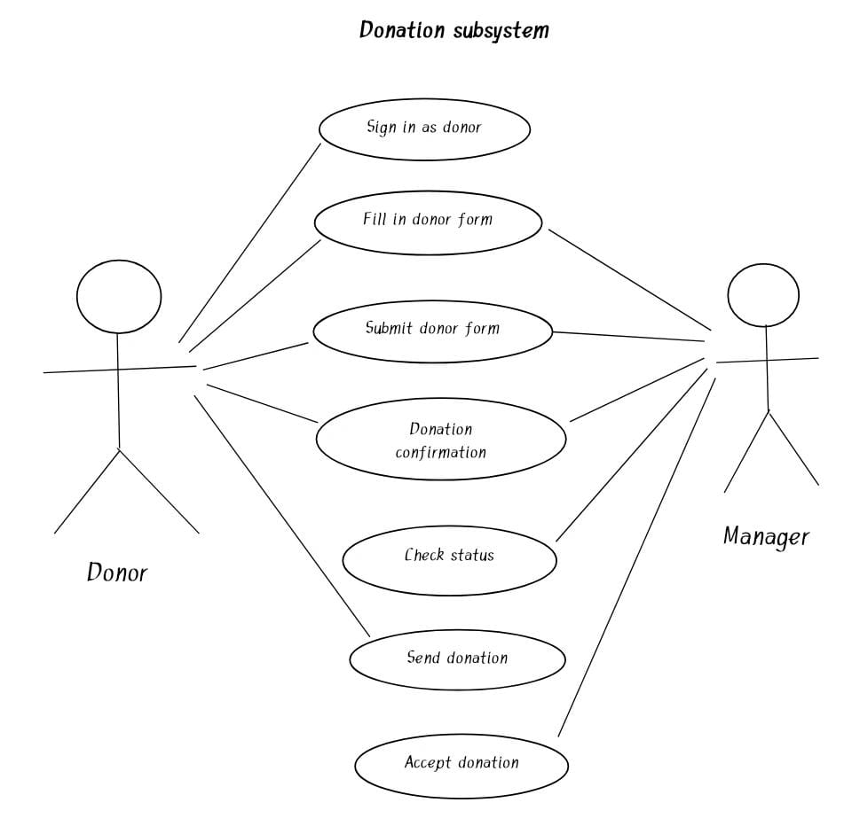
Use Case Diagram

Slide 9
CONCLUSION
This application will be the most user-friendly platform to enrol people in such good activity and will save many lives of the people who are dying due to lack of organ donation. It will create a long-term lifesaving role for every citizen in our country. Our prime target is to provide organs to the seeker when they are in need and make it a life saver platform for those who are dying due to the lack of organs and also targets the human race and spreads the concept of saving life after one's death.

Slide 10

Any Queries?

Slide 11


